Slide 1
Chiba campaign 2019
Yamaguchi Kodai
11月25日更新
DN=329

Slide 2
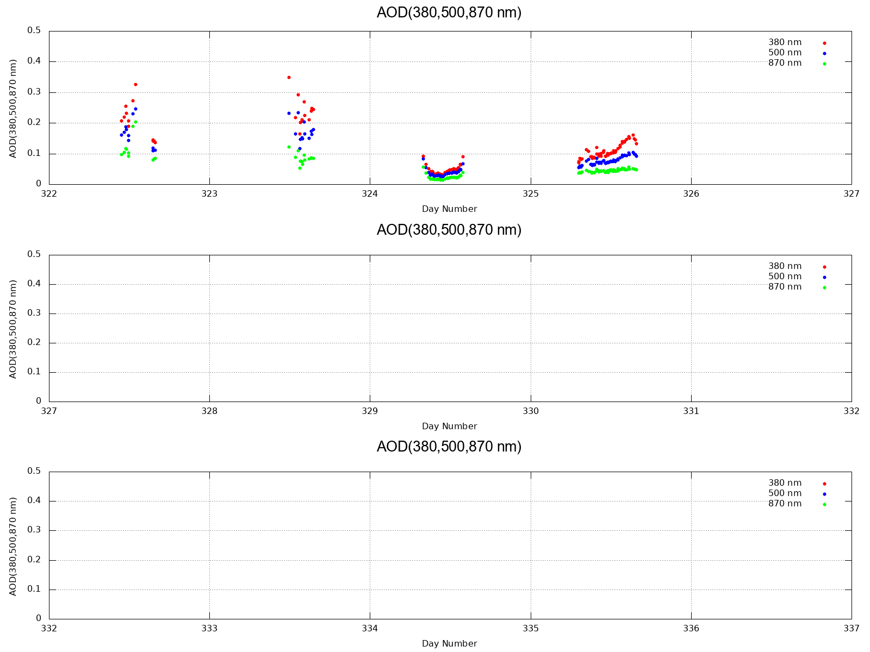
AOD (380,500,870 nm)

Slide 3
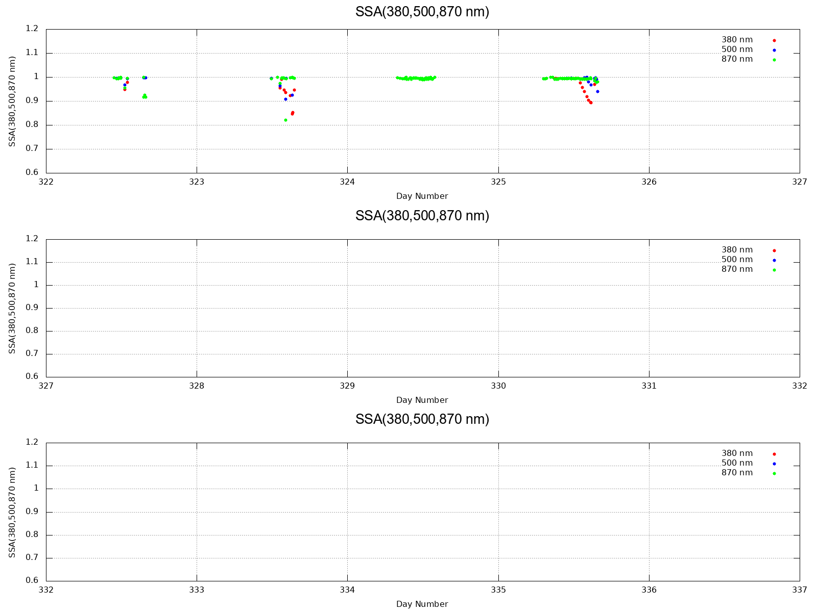
SSA (380,500,870 nm)

Slide 4
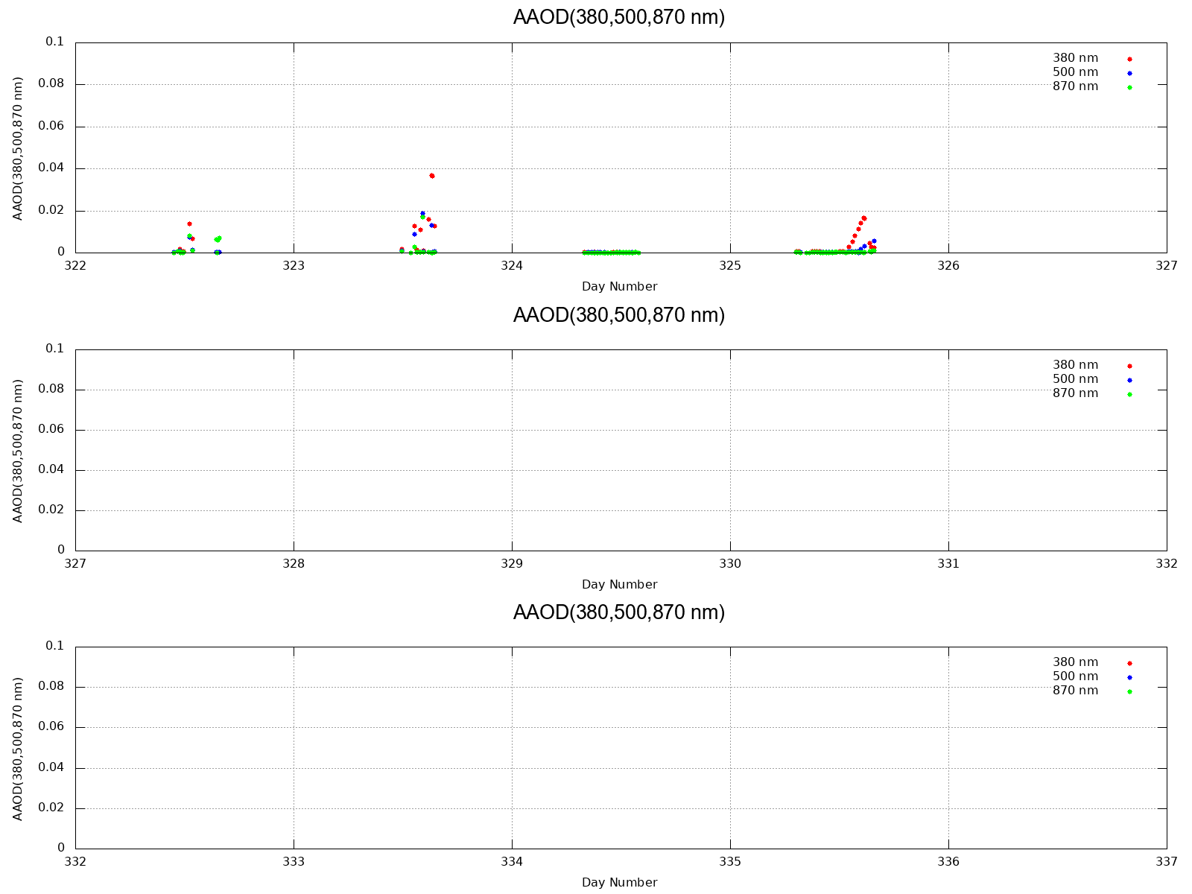
AAOD (380,500,870 nm)

Slide 5
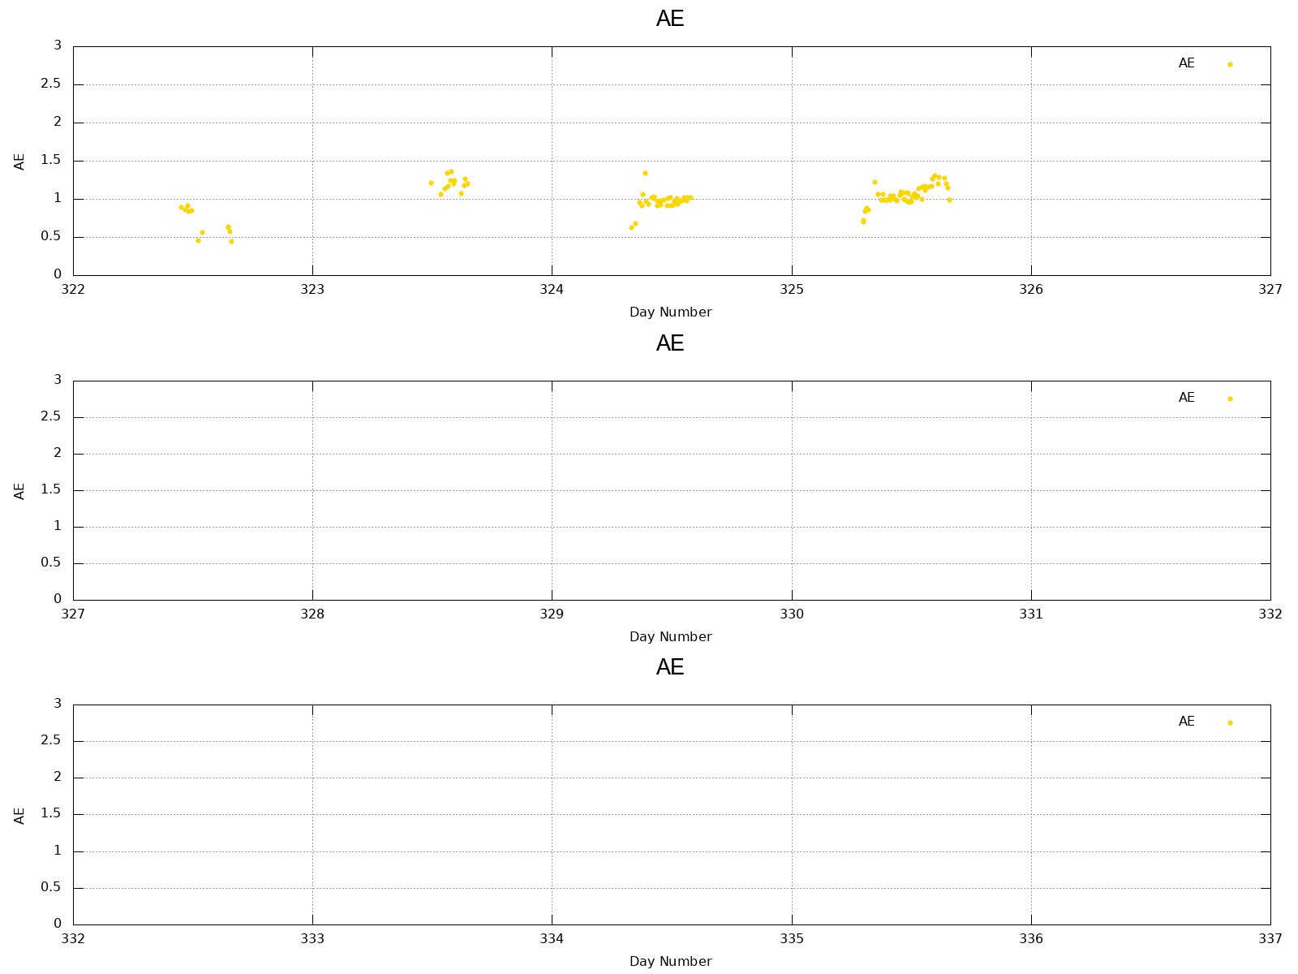
AE

Slide 6
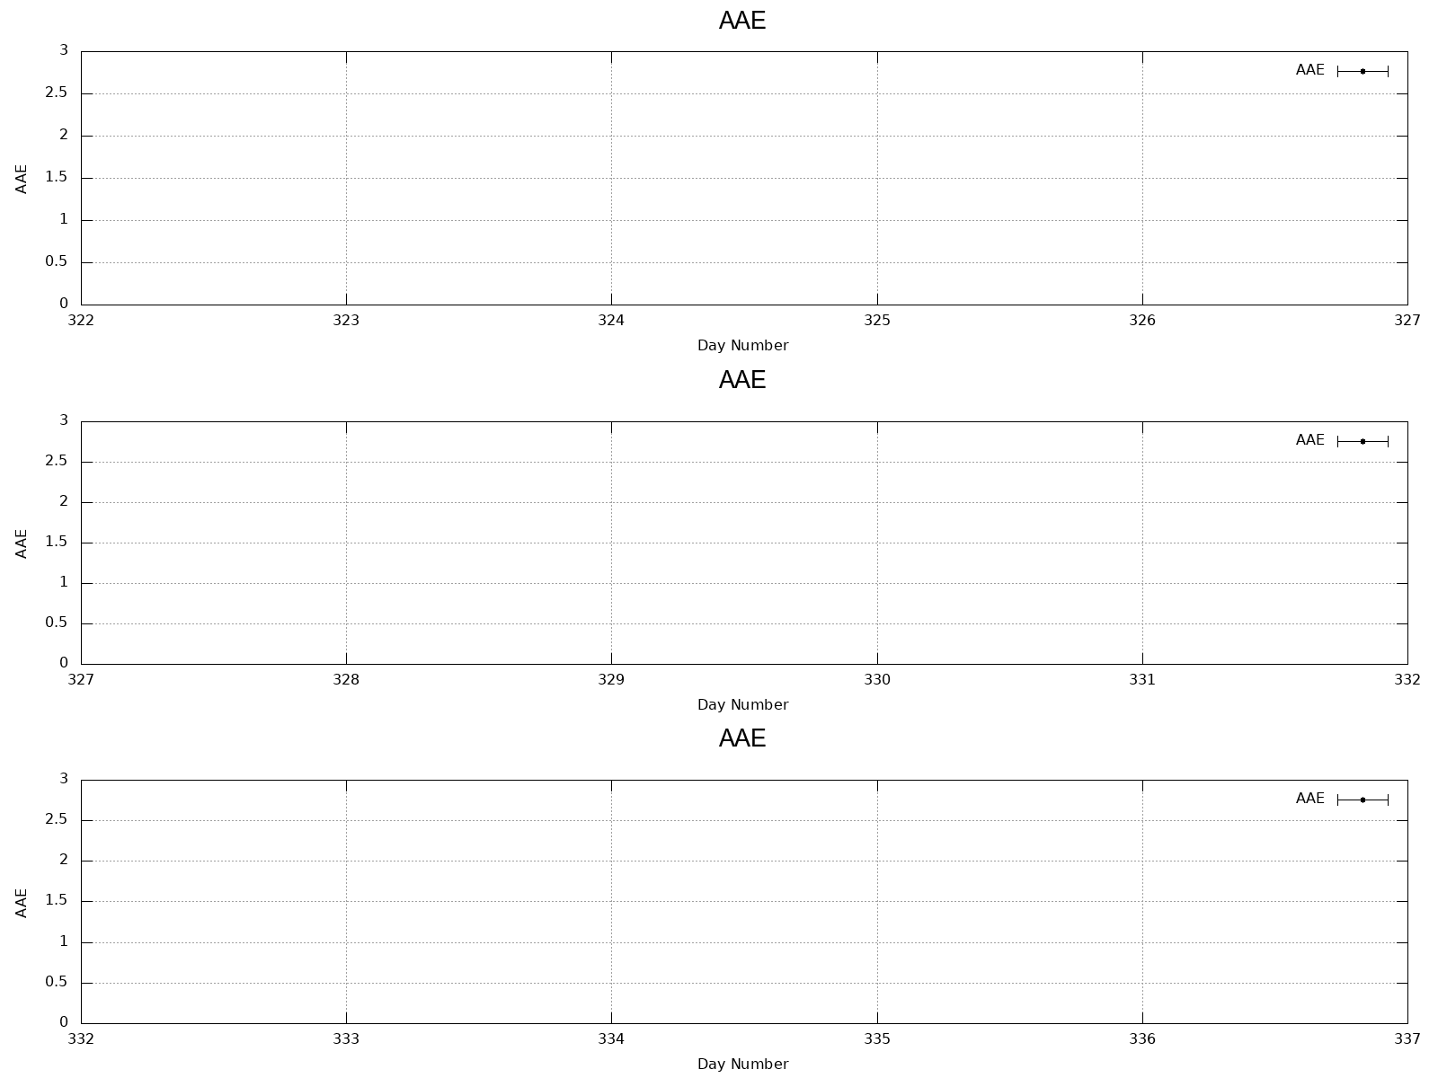
AAE (340~870 nm)

Slide 7
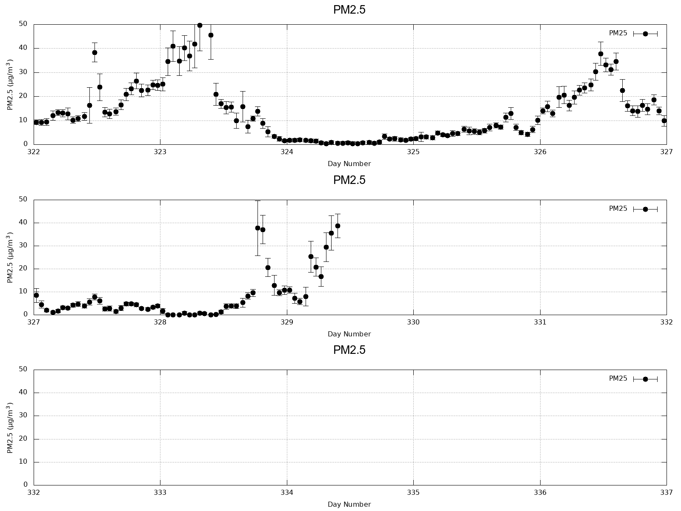
PM2.5 (1h)

Slide 8
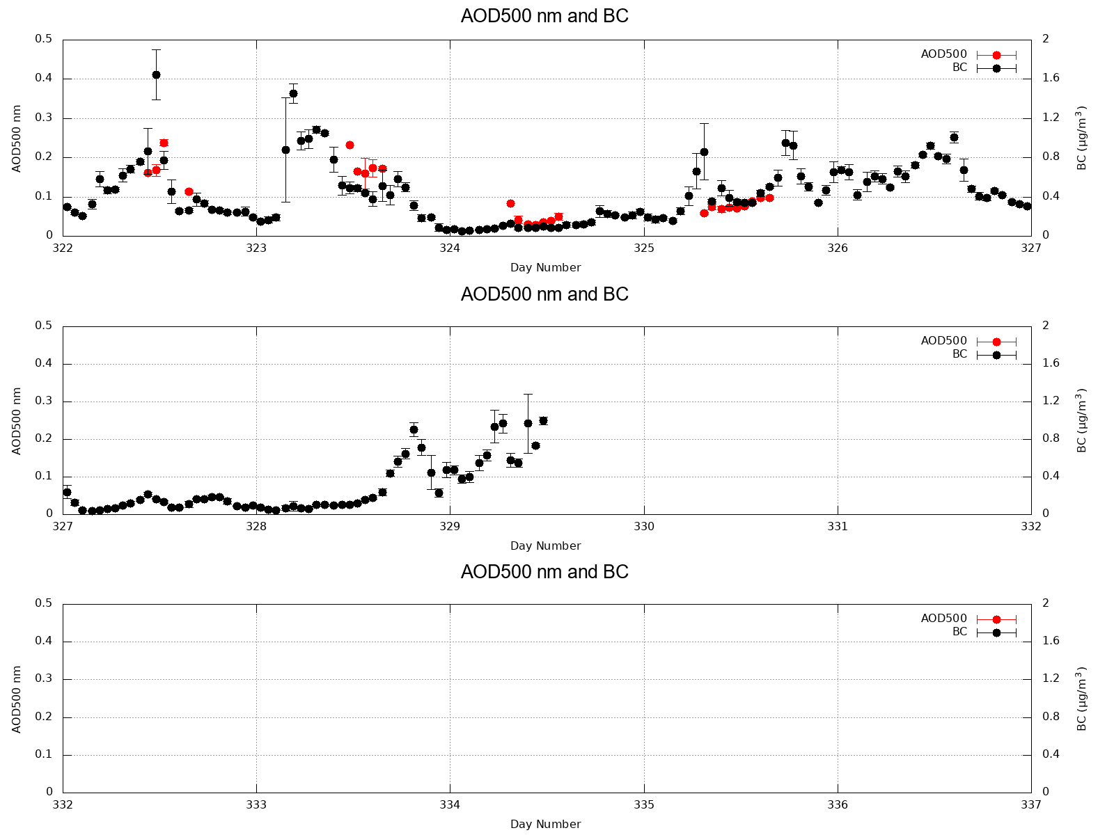
AOD(500 nm) and BC (1h)

Slide 9
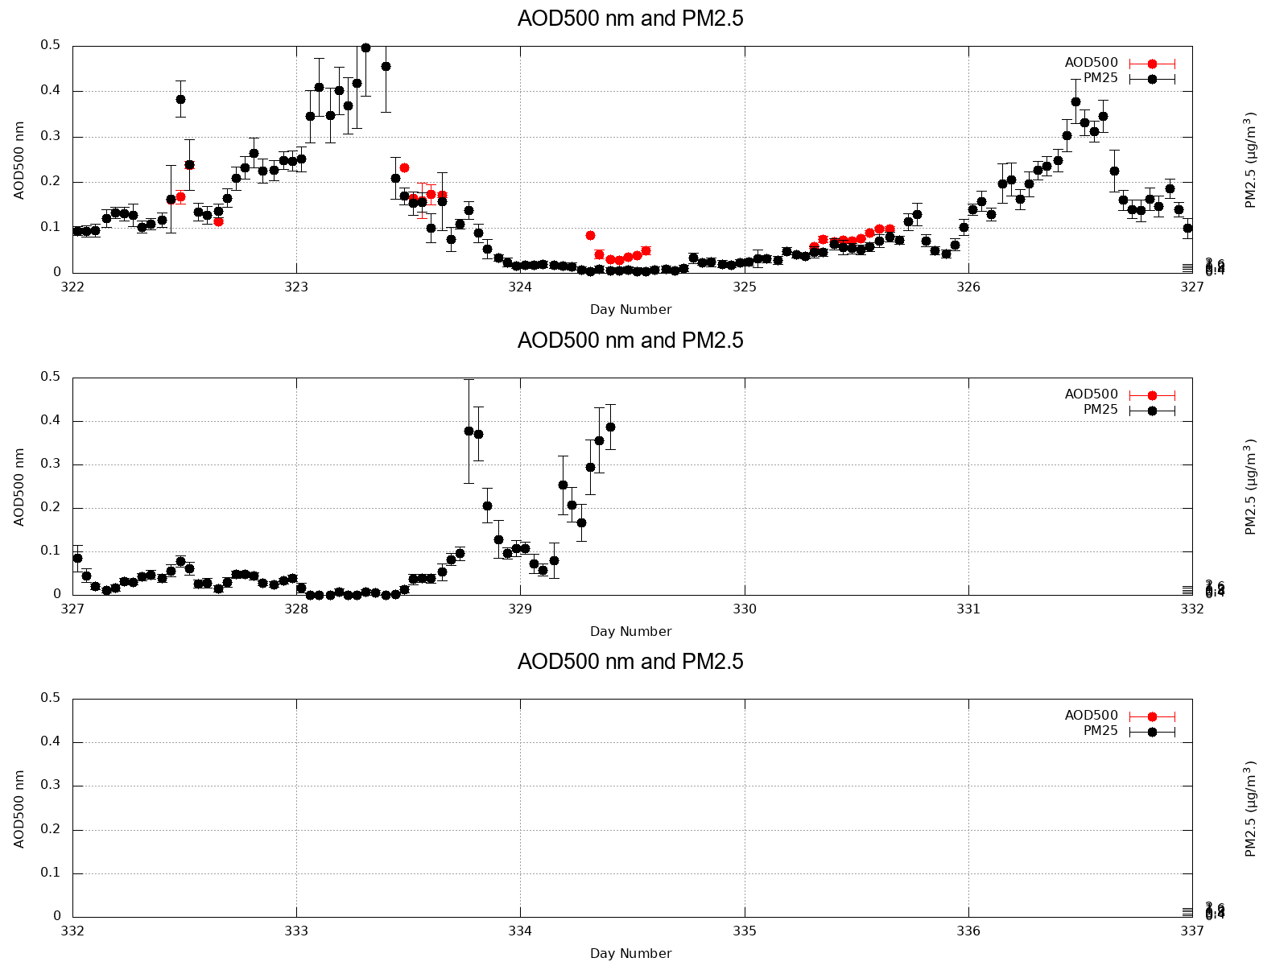
AOD(500 nm) and PM2.5 (1h)

Slide 10
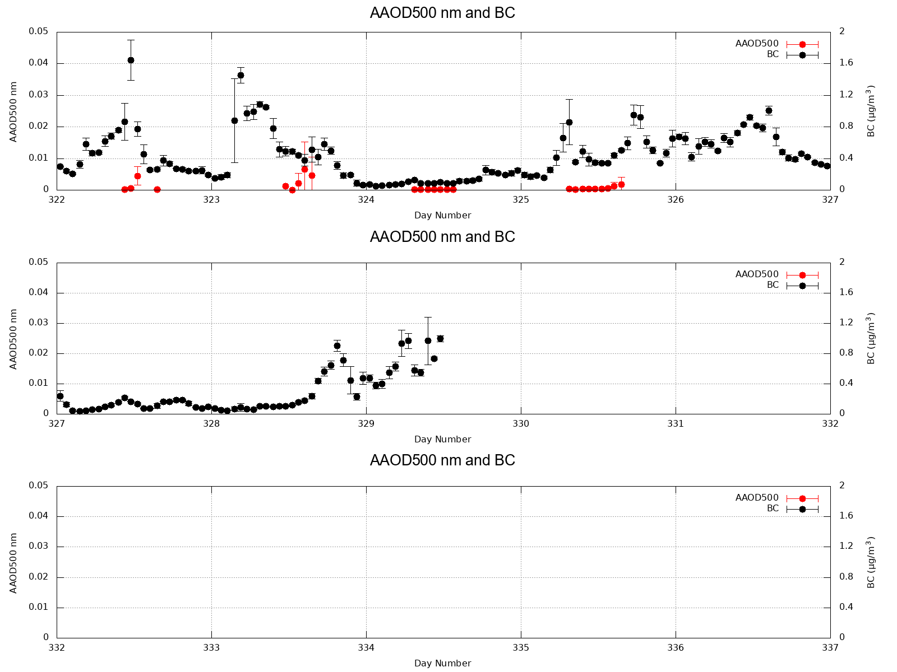
AAOD(500 nm) and BC (1h)

Slide 11
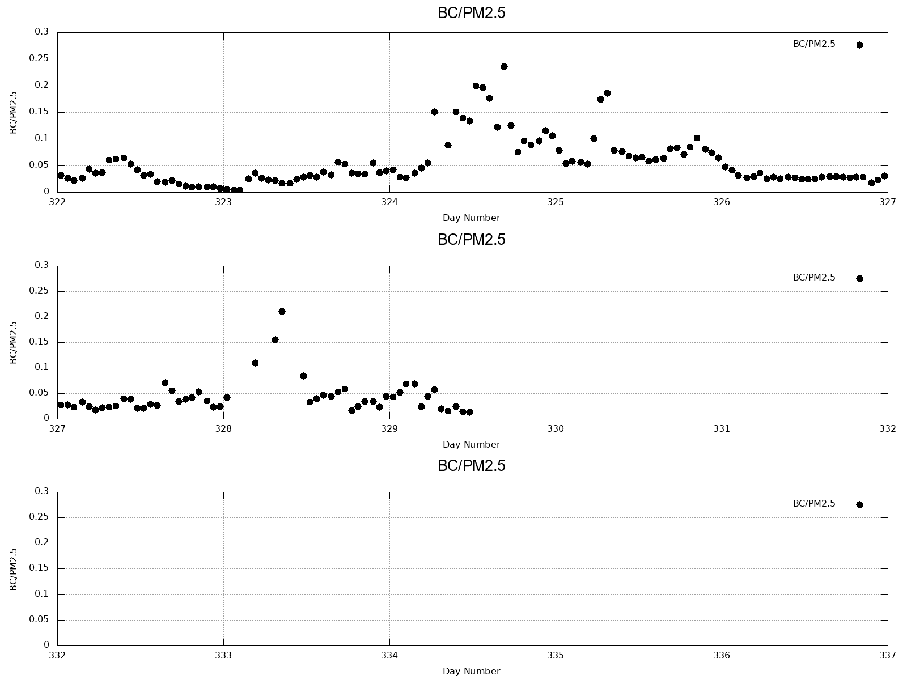
BC/PM2.5 (1h)

Slide 12
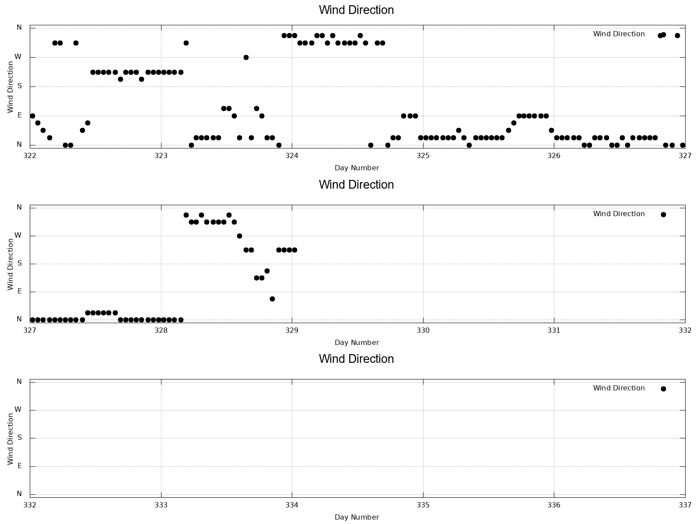
Wind Direction (1h)

Slide 13
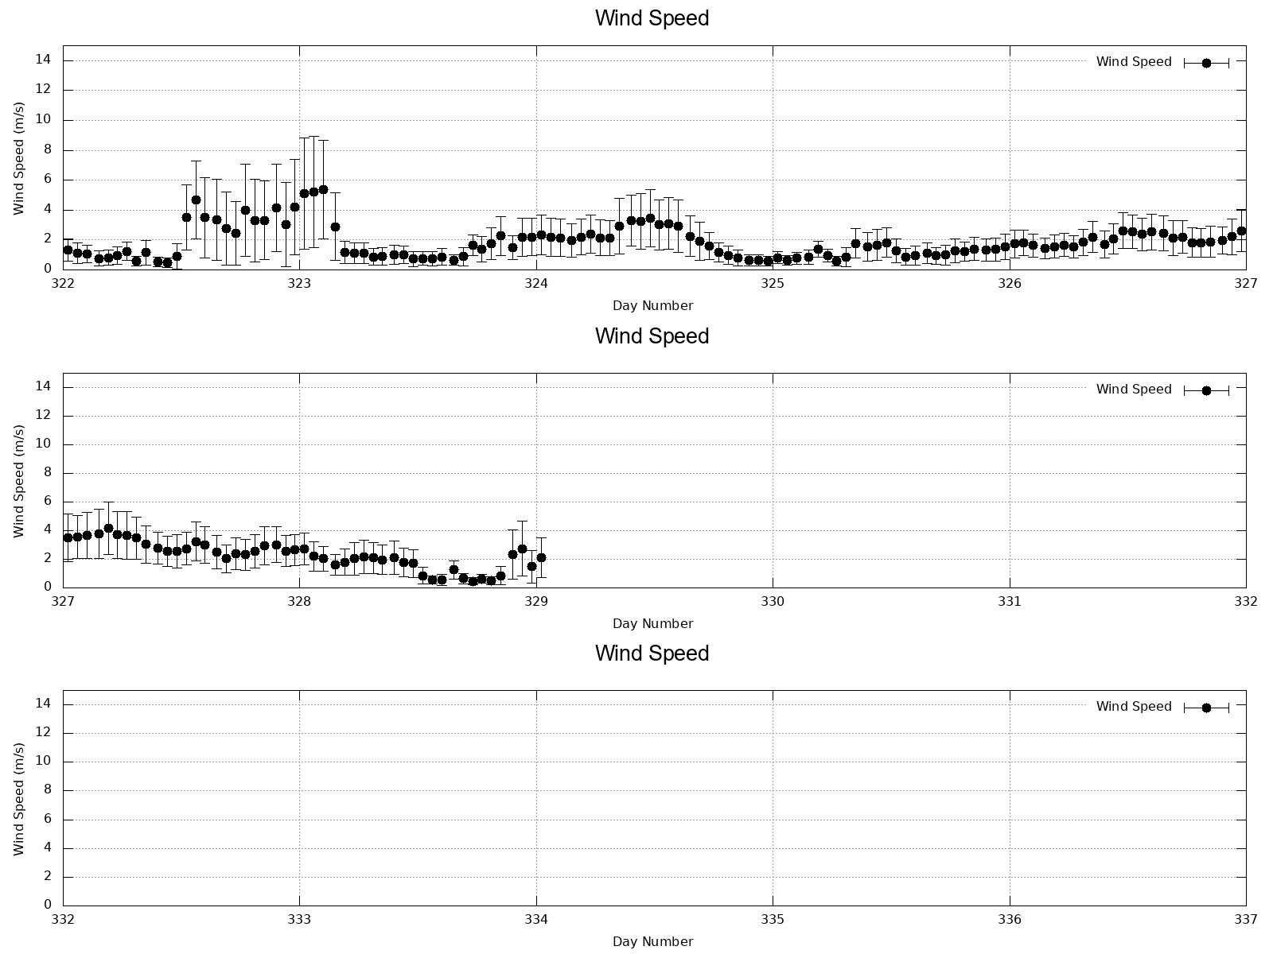
Wind Speed (1h)

